Slide 1
Introduction to machine learning in R!

Slide 5
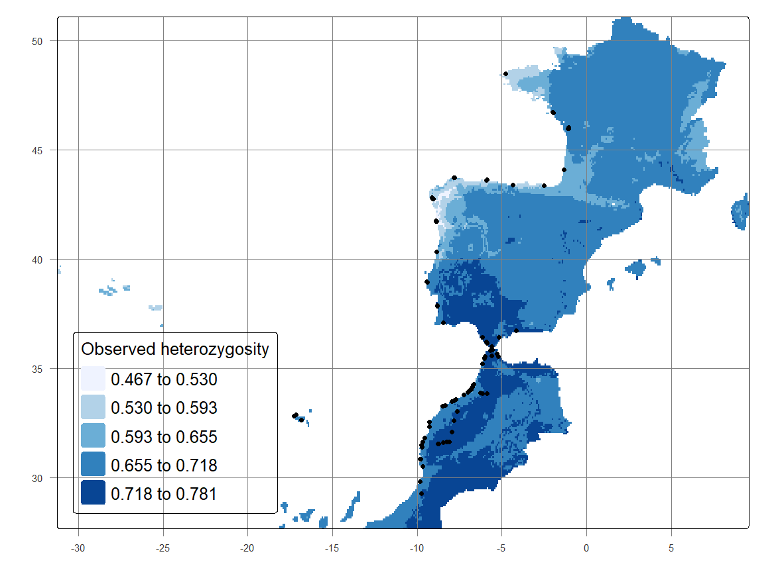
Case study: What is the posible expected heterozygocity for Beta vulgaris (Sugarbeet)
https://github.com/ccsosa/Interpolate-Genetic-diversity

Slide 6
